Slide 1




Notes:
Recording: https://youtu.be/fzjONleYwjA
Ok,
Have you ever changed your opinion or a decision when you read news or a rumor?
How many times has someone shared you a link to a news?
When it comes to politics in Latin America we are more afraid about the fake news in vote’s season.
Therefore, between Mexico, San Salvador and Colombia Chapters, ee decided to collaborate together

Slide 2
Politics Fake News Detector in LATAM (Latin America)
Notes:
Recording: https://youtu.be/fzjONleYwjA
Ok,
Have you ever changed your opinion or a decision when you read news or a rumor?
How many times has someone shared you a link to a news?
When it comes to politics in Latin America we are more afraid about the fake news in vote’s season.
Therefore, between Mexico, San Salvador and Colombia Chapters, ee decided to collaborate together

Slide 3


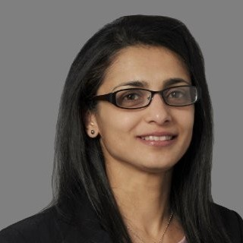



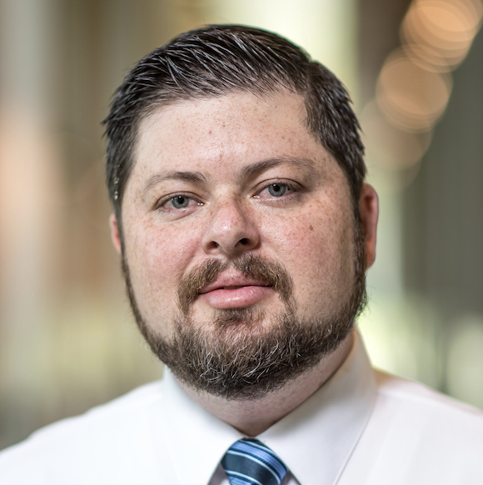

Participants
Andrés Pitta
Brandon Copeland
Gouri Kulkarni
Isaac Rodríguez
Gary Astorga
Ibrahim Koicha
Victor Cuspinera-Contreras
Armielyn Obinguar
Notes:
We really appreciate the support of 8 change makers that joined and collaborated together to perform the project in two months

Slide 4
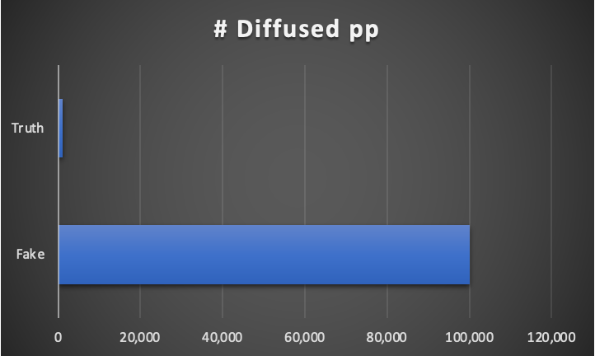
Metrics
Vosoughi, et al. mentioned that in Twitter from 2006 to 2017 about 126,000 rumors were spread by ∼3 million people
Notes:
To have a better understanding of the metrics and the impact of the missinformation
Vosoughi, et al. mentioned that in Twitter from 2006 to 2017 about 126,000 rumors were spread by ∼3 million people
top 1% of false news cascades diffused to between 1000 and 100,000 people, whereas the truth rarely diffused to more than 1000 people.
To understand how false news spreads, Vosoughi et al. used a data set of rumor cascades on Twitter from 2006 to 2017. About 126,000 rumors were spread by ∼3 million people. False news reached more people than the truth; the top 1% of false news cascades diffused to between 1000 and 100,000 people, whereas the truth rarely diffused to more than 1000 people.
From 570 fake news websites and 10,240 fake news stories on Facebook and Twitter between January 2015 and July 2018. User interactions with false content rose steadily on both Facebook and Twitter through the end of 2016. Since then, however, interactions with false content have fallen sharply on Facebook while continuing to rise on Twitter, with the ratio of Facebook engagements to Twitter shares decreasing by 60 percent.

Slide 5
LET’S DO A MVP!!!
Politics Fake News Detector in LATAM (Latin America)

Slide 6
What are the benefits of detecting false/fake news?
Detect frauds
Detect fake accounts
Limit its spread
Help Misinformed people
Notes:
Why are we doing this MVP?
It’s because the potential of fake news detector can…
Detect frauds
Detect fake accounts
Limit its spread
Help Misinformed people

Slide 7
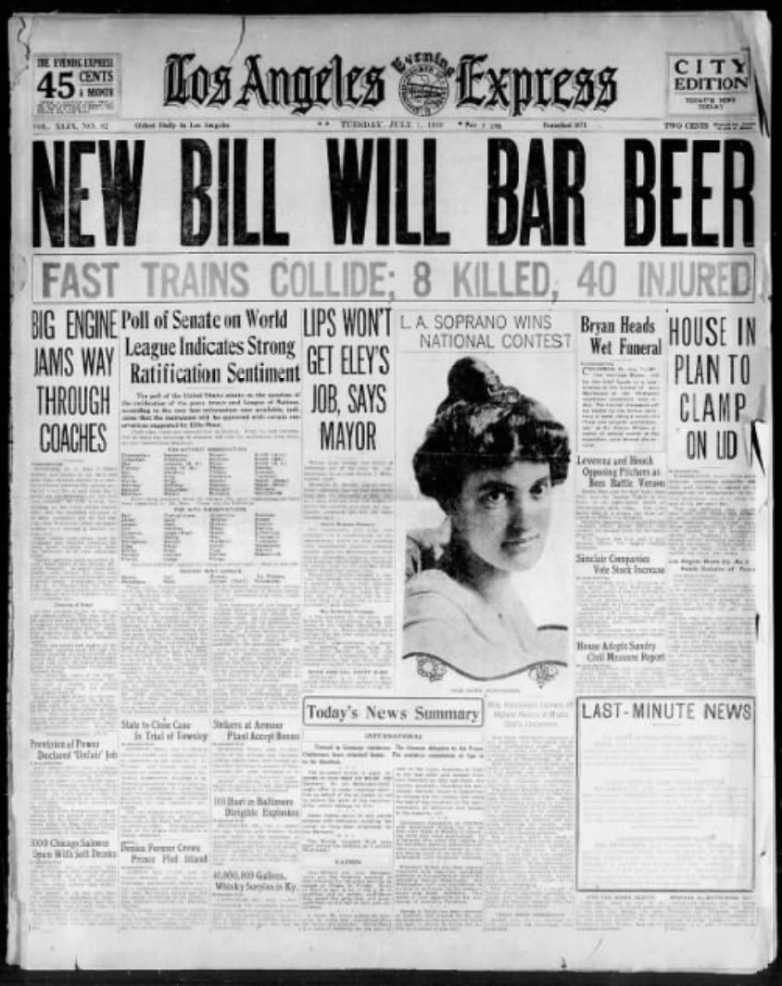
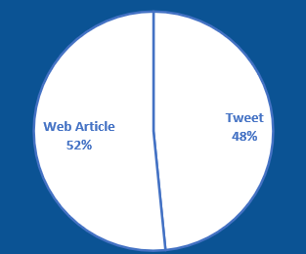
The first challenge of the project was extracting data
News articles and tweets are generally publicly available, so they were extracted by using scrapers and Twitter’s APIs.
We extracted 1.500 tweets and 1.599 Web Articles, from 2013 to 2022.
Source: Wikimedia
Notes:
At the beginning of the project in a way these were the first questions we had.
Do we have data? No
How will we get the data? By extracting data using a scraper on web pages and twitter.
How will we define that a web article or a tweet is true or false?
This is where different members of the team started to find out what could help us define if a new was true or fake.

Slide 8

When we receive an article, How can we tell it is Fake?
Is the information exaggerated?
Is the source of the data missing?
Is the article’s source a reliable media outlet?
Is it showing up in fact checking web pages as Fake?
Is the article omitting data?
Source: Wikimedia
If the majority of the questions are answered by a Yes, then we consider the article as Fake
Notes:
In order to label data we formulated within our research about 5 questions, where If the majority of the questions are answered by a Yes, then we consider the article as Fake

Slide 9


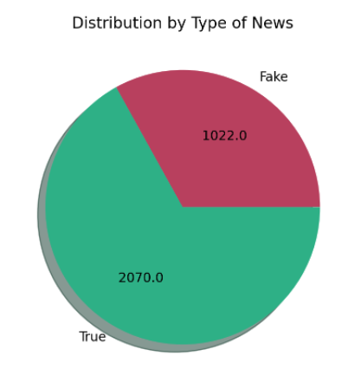
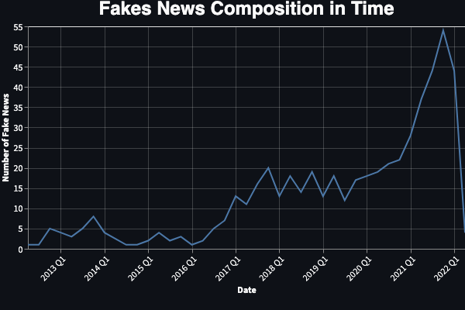
Labeling
1,000 Web Articles
1,000 Tweets
1,000 Non-corrected Tweets & Articles
Notes:
NAME
Thanks to the support of Labelbox tool and Data Engineering Latam we could perform the labeling where we labeled:
1000 wbe articles
1000 twitter
And 1000 non corrected tweets & Articles
Where about 70% where True and 30% fake
--------
Just a comment: If you are referring to the name of the grouping that supported the labelling, it was Data Engineering LATAM. If you are referring to the names of the people I understand that they are the ones mentioned in slide 4.

Slide 10

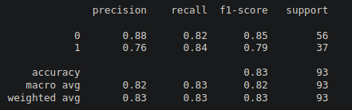
Model Stats Cont.
Below are some sample statistics for the highest performing model using Gradient Boost:
With support from Omdena, we were able to secure a Google Colab Pro account that aided in model training time and with a 20% jump in accuracy.
Notes:
(Isaac) Once data was tagged the next step was to explore the creation of an AI model that allows us to automatically predict whether a piece of news is fake or not. We observed we could train a model with good enough performance. So, Mario will now talk about model interface that we created.

Slide 11
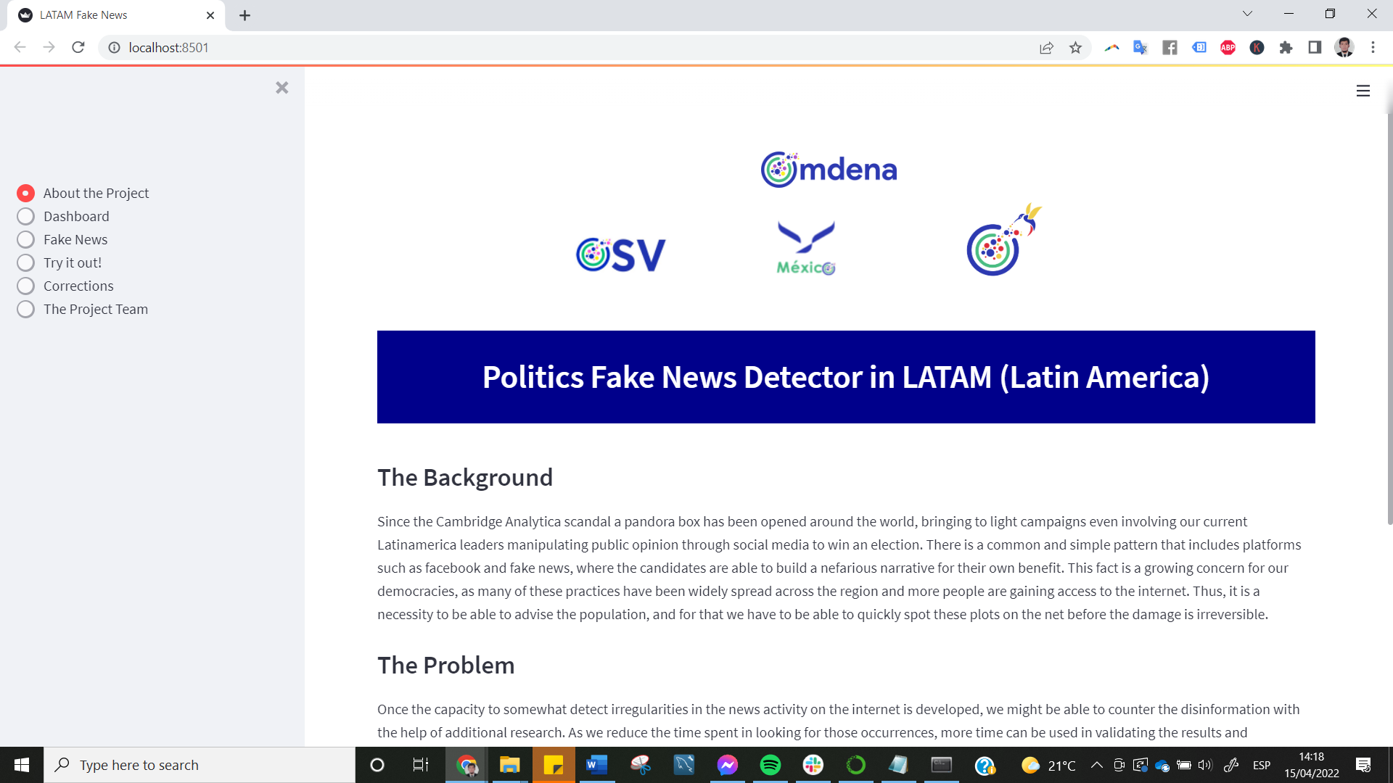
Link: Politics Fake News Detector in LATAM
Notes:
(Isaac) Update image in case something is changed in streamlit or in case it is moved to Heroku.

Slide 12



Competition
Notes:
Our competition is pretty limited in the english language or is only for their respective social media with its own controls. Hence, we made this this tool also for the public and available for spanish language. Not to mention, we have a proposal for the next steps…

Slide 13
Outcomes of survey - 10 people asked & 100% validate our ML outcome on fake news detection
“Useful when doubts are present in news, articles or websites”.
“People could use it also for validating rumors in viral news”
Some respondents suggest to also use audio transcription and adapt it as a plugin in Google Chrome.
Notes:
After the creation of our MVP we formulated a survey to get feedback. 10 people responded and a 100% of them validated the system. As you can see, for example, some respondents suggested to also use audio transcriptions and adapt it as a plugin inside a web browser.

Slide 14




Next step proposal
Dynamic AI Model
Checklist
User suggestion
References to other sources
Spanish NLP model
Fact Checker validation
Report as fake news
What have other sites written about the same event/news
Notes:
(Isaac) The proposal for the next steps is threefold: 1. We plan to create more robust and dynamic AI model that can check the context in real time 2. Consider checklist to improve predictions and explainability 3. Allow users suggest fake news reporting

Slide 15


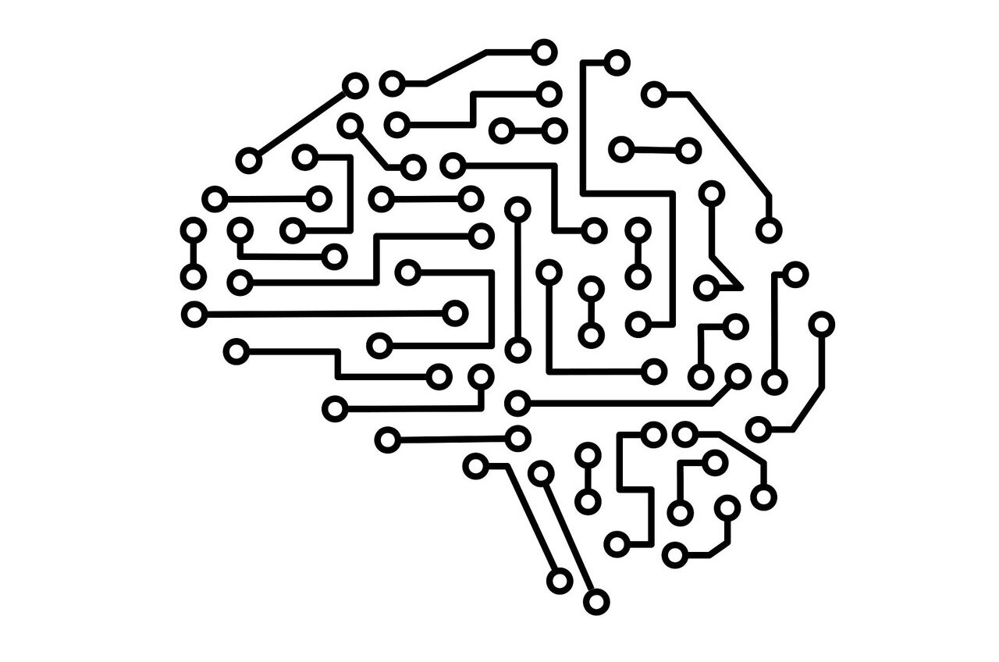
Target solution
Heuristics + Model = Prediction
Validation’s news score: Low
How did we get the score?
The author included references to other sources to back up his/her claims.
Our AI model scored a low probability of the news being fake.
...
Click to find out how to spot a fake news
Notes:
(Isaac) and this is an example of how our proposal could look as a plugin

Slide 16
Further actions and needed resources
Big Data Gathering.
Research and experimentation on an AI model building.
Deployment with Cloud Resources.
Sustainable Business model for maintenance and constant improvement.
Notes:
Finally, these are the actions and resources that will be needed: 1. Continue data gathering 2. Get cloud resources for deployment 3. Implement sustainable business model to maintain and improve the system, and continue research and experimentation on AI models.

Slide 17
News Veracity validator
- PHASE 1 -
Notes:
In the first phase (the current one), we’ll research and implement a context search engine with all the possible models.
In the second phase, we’ll try to optimize our models, select the best ones, deploy them and build a plug-in accordingly.

Slide 18
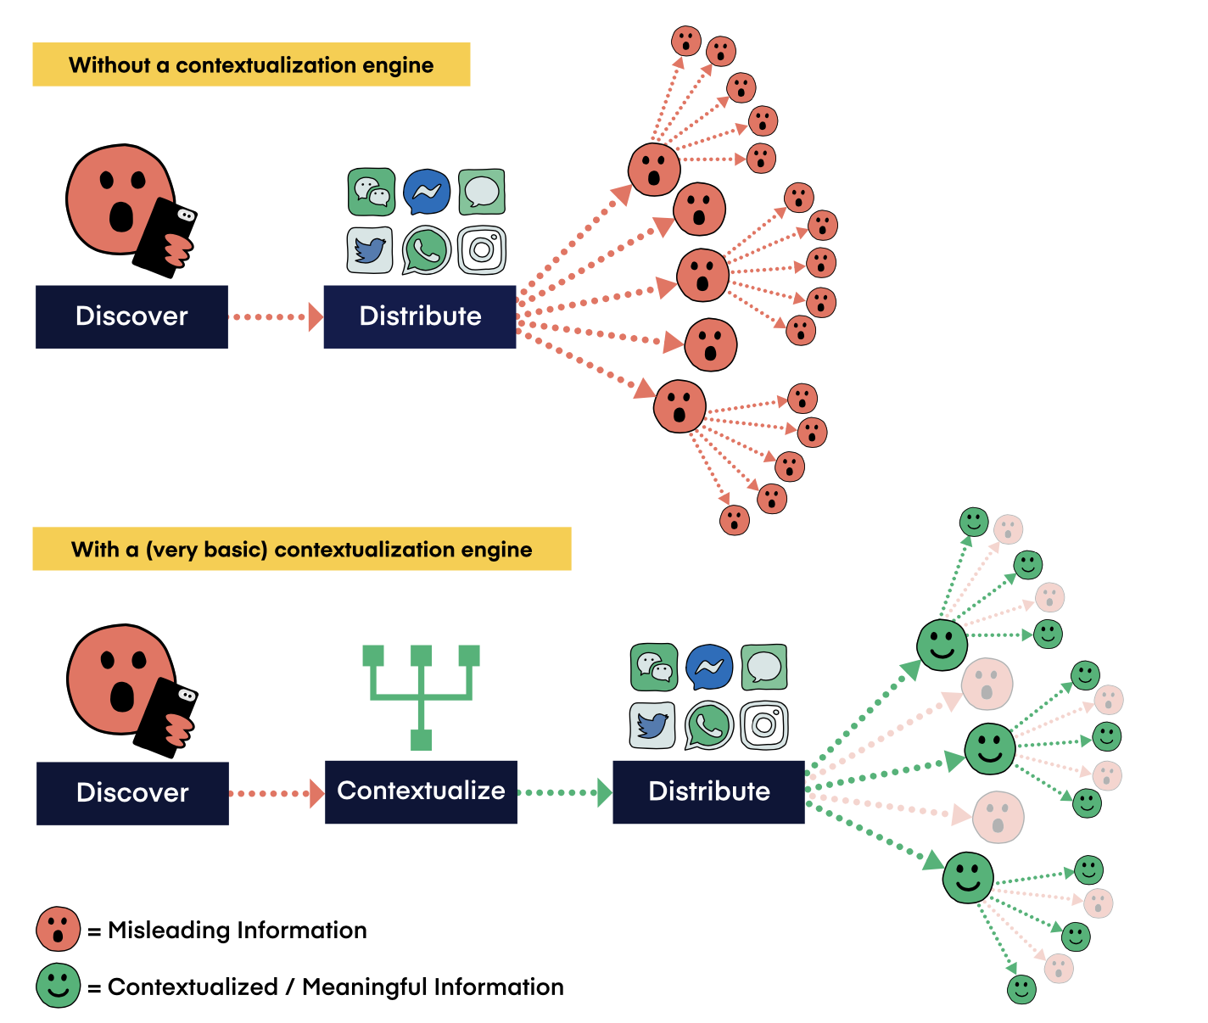
What’s a context engine?

Slide 19
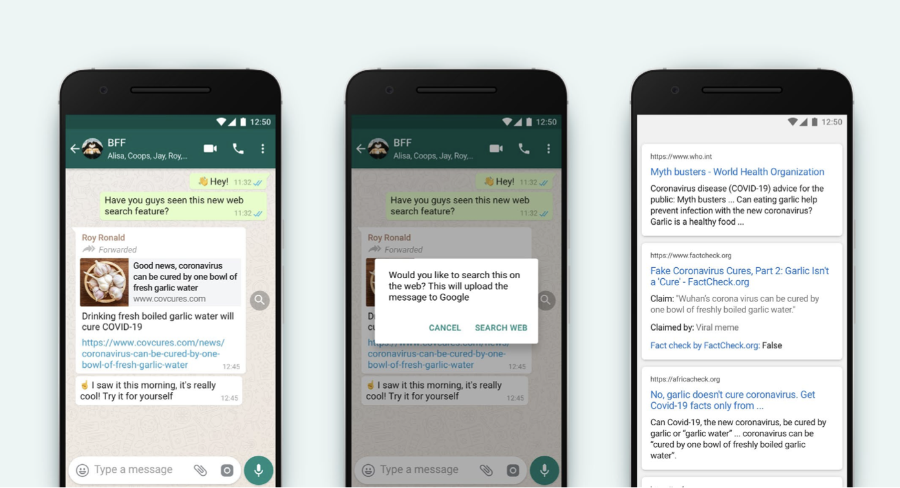

Slide 20
Some characteristics
Contextualization engines can help people make sense of the information that they come across online by making ‘media literacy work’ less time-consuming.
A “contextualize button” to push media to a contextualization engine could be built into everything — from social media and messaging apps to operating systems; a normal and expected part of software interfaces.
New AI technology allows computers to understand media in ways that were not possible before, allowing contextualization engines to more effectively sort through information.

Slide 21
GOALs
Research state-of-the-art models/algorithms of a context engine searcher.
Implement the top context search models or algorithms.
Automate a context search model/algorithm

Slide 22
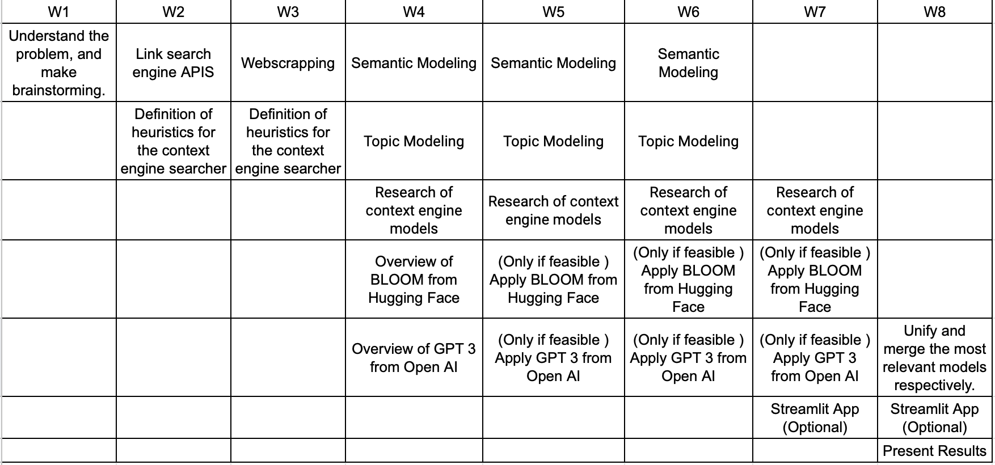
TIMELINE & WORKSHOPS
Notes:
Webscarpping
Semanting and topic modeling
Parallel training with TPUs for Hyperparameter optimization.º

Slide 23
EXPECTATIONS
Playground to try any idea, solution and other things than the current timeline.
Pretty pretty proactive (Propose any meeting, task/sub task or activity)
Read articles, bring updates, bring new ideas!.
Work with passion!! If it’s not fun, let’s talk how we can make it !!

Slide 24
NEXT STEPS
Slack
Github (Expected everyone to be already registered)
Task leads & benefits
Weekly Meeting - >Google Calendar

Slide 25
THANKS TO ALL!
Notes:
We would love to invite you to join us on fighting misinformation. Thanks for your attention!

Slide 26

Improving labeling guidelines
From twitter Rules and Policies:
Is the content significantly and deceptively altered, manipulated, or fabricated?
Is the content shared in a deceptive manner or with false context?
Source: https://help.twitter.com/en/rules-and-policies/manipulated-media
Notes:
Isaac

Slide 27

Mentors/Speakers
Data gathering | Topic Modeling and Modeling
Anellee Nurkayeva | Abhishek Singh Rathore
Notes:
The two mentors from Omdena’s Community that supported

Slide 28

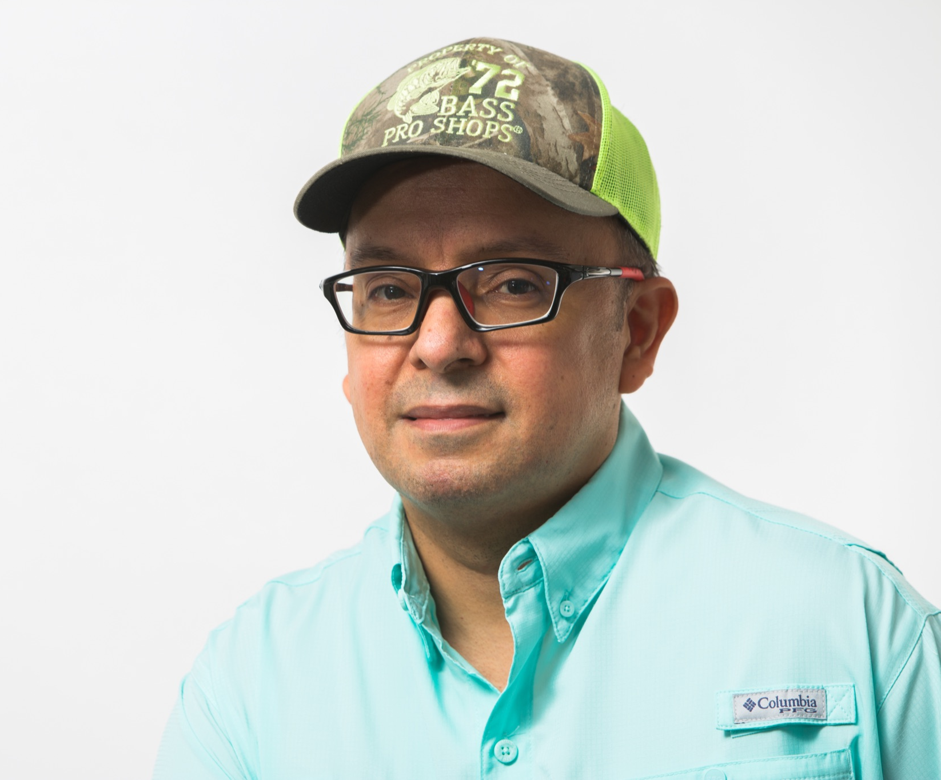
Data Labellers
Juan Carlos Rivas
Eugenis Villamizar
Gilberto Nava Marcos
Ramón Iván Puón Meraz
Notes:
The 4 external labellers from the partner Data engineering Latam

Slide 29


Chapter Leads
Giancarlo Pablo
Miguel Correa
Notes:
The other two chapter leads that planned with Mario /me planned its scope and timeline for about a month before it began

Slide 30
Call to actions
Mentorship
Partnership
Sponsorship
Notes:
Mario

Slide 31
Misleading media (Twitter)
Altered
Manipulated
Fabricated
Shared with false context
Cause confusion on public issues
Impact public safety
Cause serious harm
Notes:
We based our knowledge of gathering

Slide 32


MVP
Is this news real or fake?
There is a common and simple pattern that includes platforms such as facebook and fake news, where the political actors are able to build a nefarious narrative for their own benefit.
Once the capacity to somewhat detect irregularities in the news activity on the internet is developed, we might be able to counter the disinformation with the help of additional research.

Slide 33

However, we did not have any indication of whether the articles were fake or not
News articles and tweet are generally publicly available, so they were extracted by using scrappers and Twitter’s APIs.
We extracted 1.500 tweets and 1.599

Slide 34
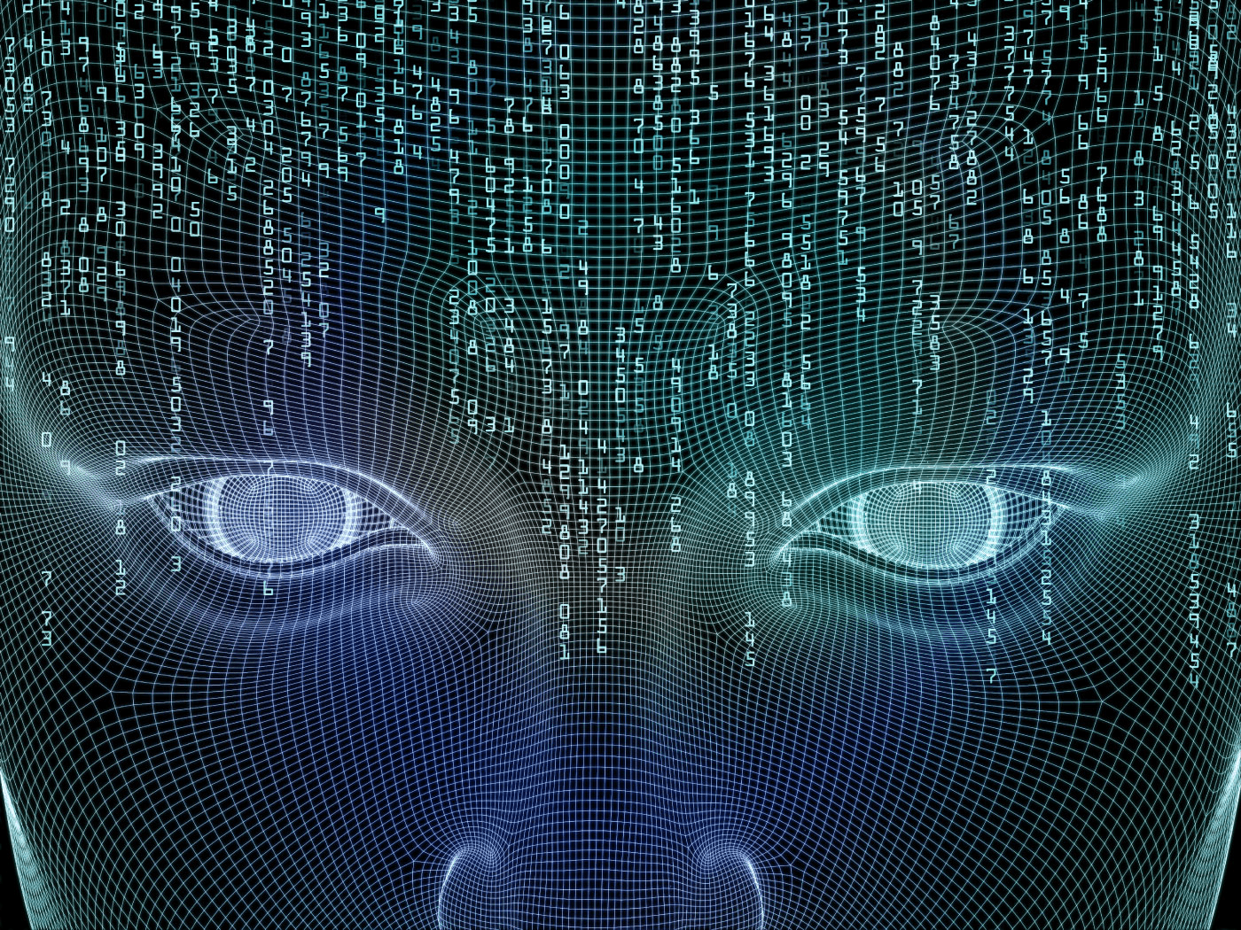
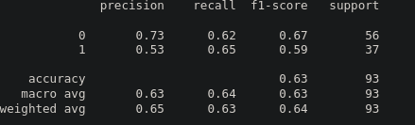
Model Stats
Below are some sample statistics for the lowest performing model using Logistic Regression:

Slide 35
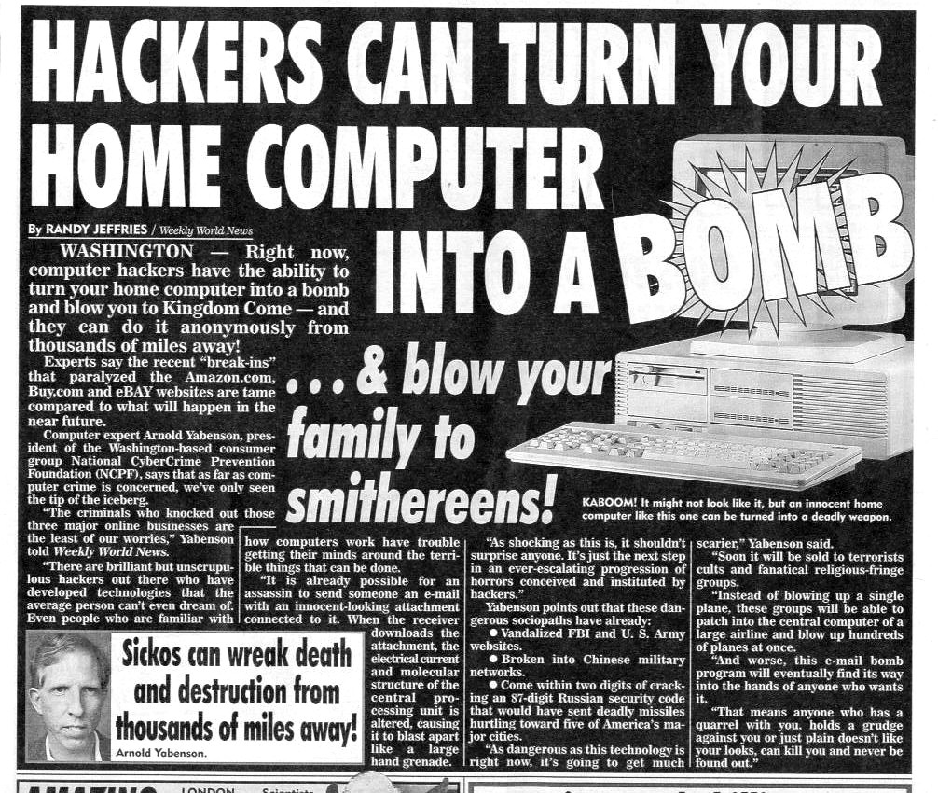


When we receive an article, How can we tell it is Fake?
We trained a Low Performance Model (Logistic Regression - Recall of around 64%). Generic dataset.
Meaning: Results were unreliable but could pick up writing patterns. Baseline to correct
Use the Low Performance Model, fact checking web pages and a 7 Questions system to correct the data.
Source: Flickr

Slide 36
What is not a fake new?
Memes or satire,
Animations, illustrations, and cartoons,
Commentary, reviews, opinions, and/or reactions.
Counterspeech.
Doctored or fake Tweets, social media posts, or chat messages.
Notes:
Mario - Que no es una noticia falsa

Slide 37
Impact of a fake news detector
Disrupting economic incentives.
Helping people make more informed decisions when they encounter false news.
To find synthetic, manipulated, or out-of-context media.
Notes:
Mario

Slide 38
New sources
Retrieval Augmentation: https://ruder.io/ml-highlights-2021/index.html#11retrievalaugmentation
What’s next for NPL: https://www.amazon.science/blog/acl-what-comes-next-for-natural-language-processing
Twitter policy: https://help.twitter.com/en/rules-and-policies/manipulated-media
Working to stop misinformation: https://www.facebook.com/formedia/blog/working-to-stop-misinformation-and-false-news
The spread of true and false news by MIT: https://www.science.org/doi/10.1126/science.aap9559
FaceBook check: https://about.fb.com/wp-content/uploads/2018/10/fake-news-trends.pdf

Slide 39
THE PROBLEM

Slide 40
What happens in social media if
News / Tweet deletion
Labeling
Account locks
Notes:
Isaac

Slide 41
Newsroom goals
We're committed to fight the spread of misinformation online, and promote plurality, through explainable AI and community engagement.
Our goals are to:
- Fight the spread of disinformation and hate speech;
- Highlight misinformation and bias; and
- Open up echo-chambers by providing a balanced view on the news;
Notes:
Solo referencia

Slide 42
More data on another Latinamerican countries.
More state-of-the art models implemented with different hyperparameters.
Data labelling opened to all spanish speakers with further statistical sampling.
Correction framework for Political Analyst to use.
Web Scraping automation and integration for further topic modeling analysis and clustering.
Plug-in creation for fake news detector in web browsers like Google Chrome.

Slide 43
DATA COLLECTION

Slide 44

ANNOTATIONS
How will we define that a web article
or a tweet is true or fake?

Slide 45
MODELLING

Slide 46
LIVE DEMO

Slide 47
FUTURE WORK

